Slide 1
Integration of Third-Party Smart Locks into the Smart Home System
Aleksandar Zagorac and Marija Antic

Slide 2
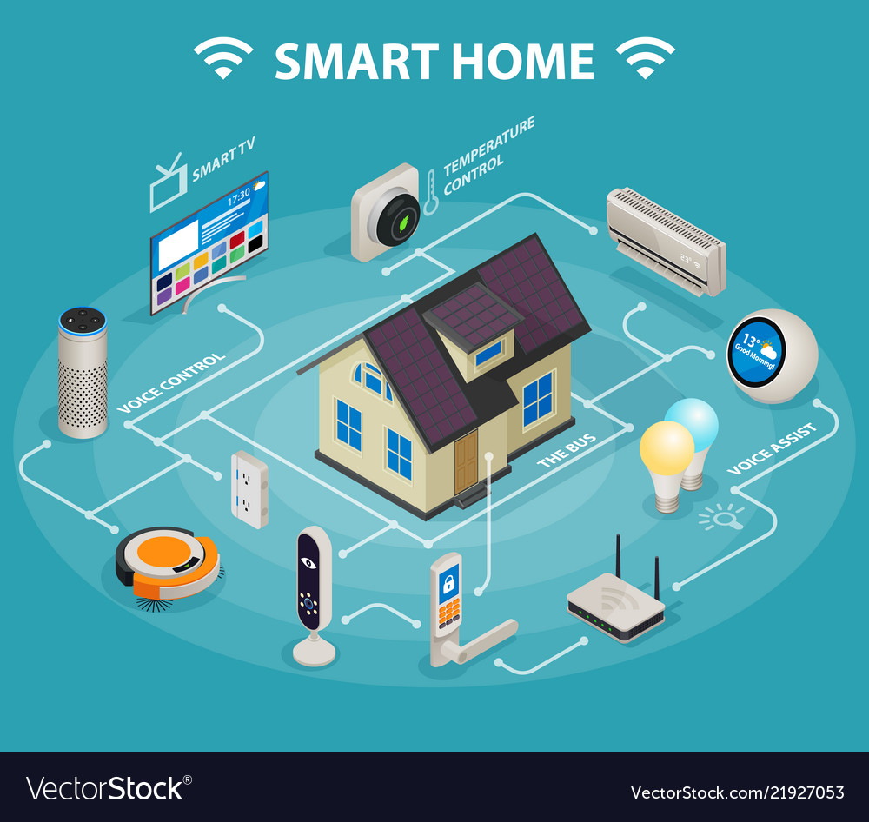

GROWING INDUSTRY

Slide 3
MULTIPLE SMART HOME COMPANIES

Slide 4
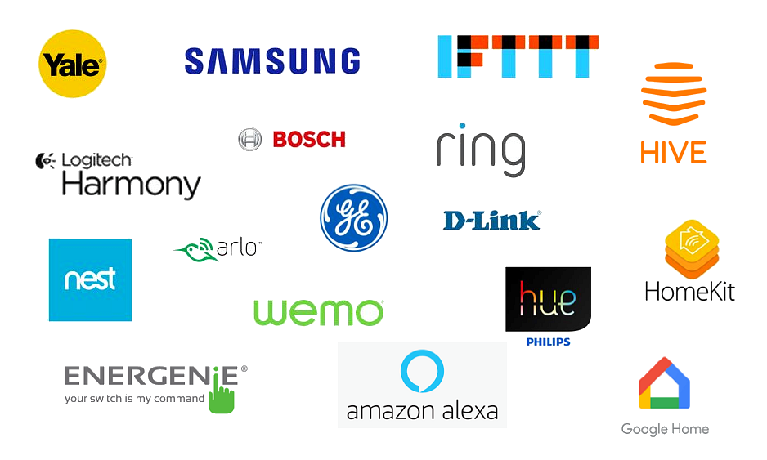

Slide 5

SOLUTIONS FOR SOME PARTS OF THE SMART HOME SYSTEM

Slide 6

COLLABORATION

Slide 7

AND …

Slide 8

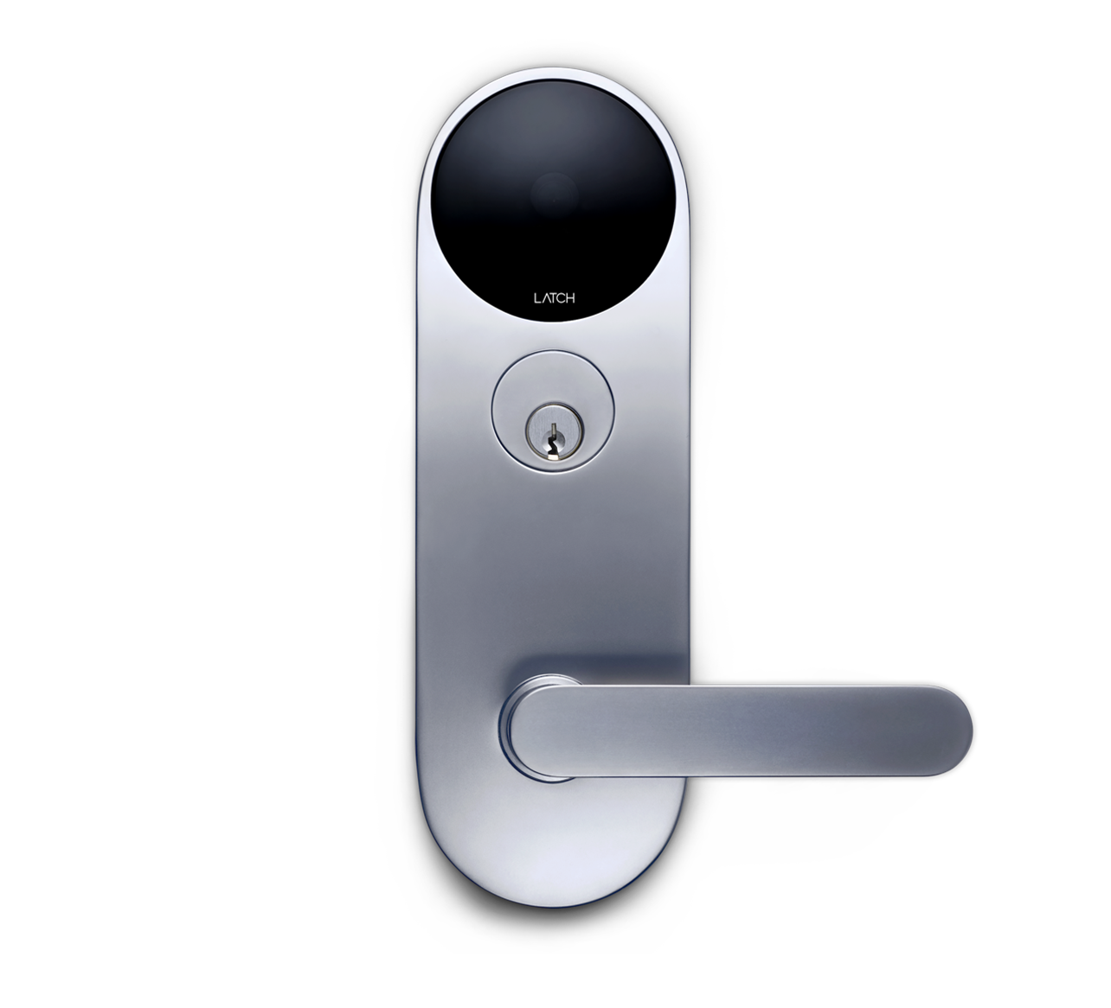
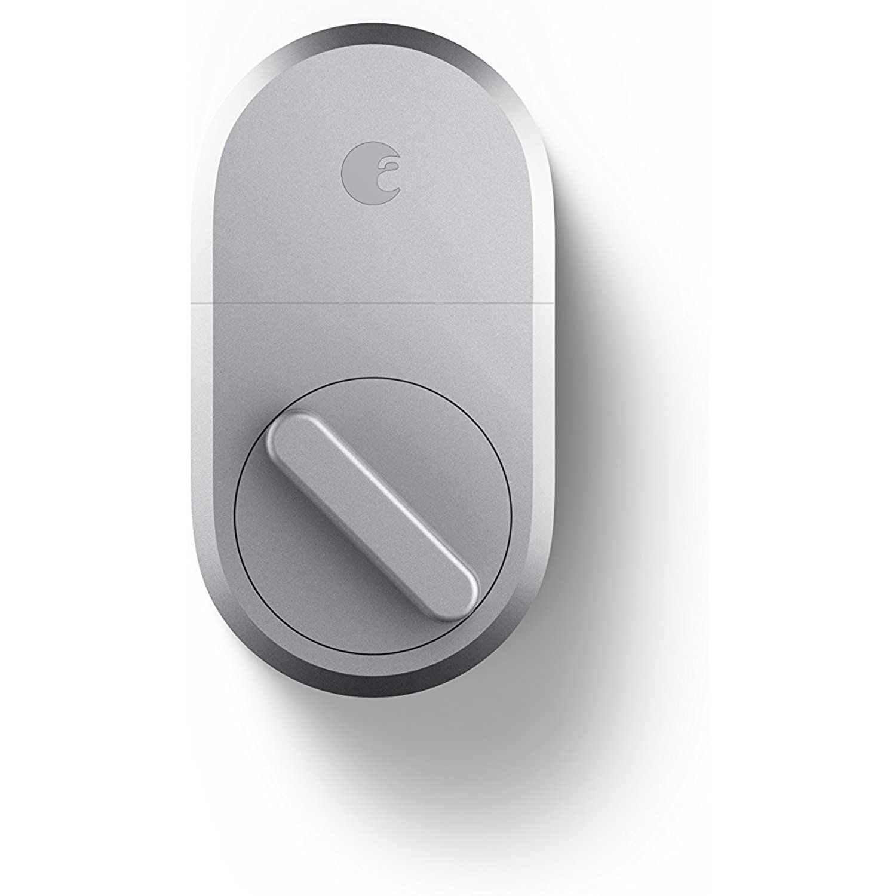
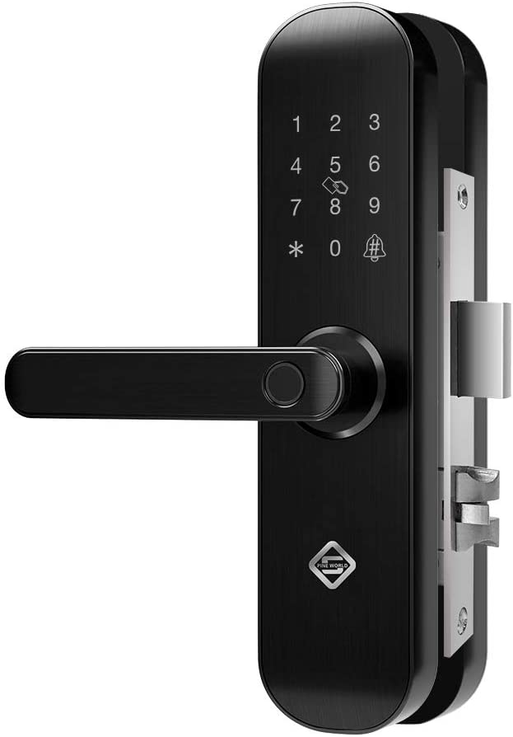
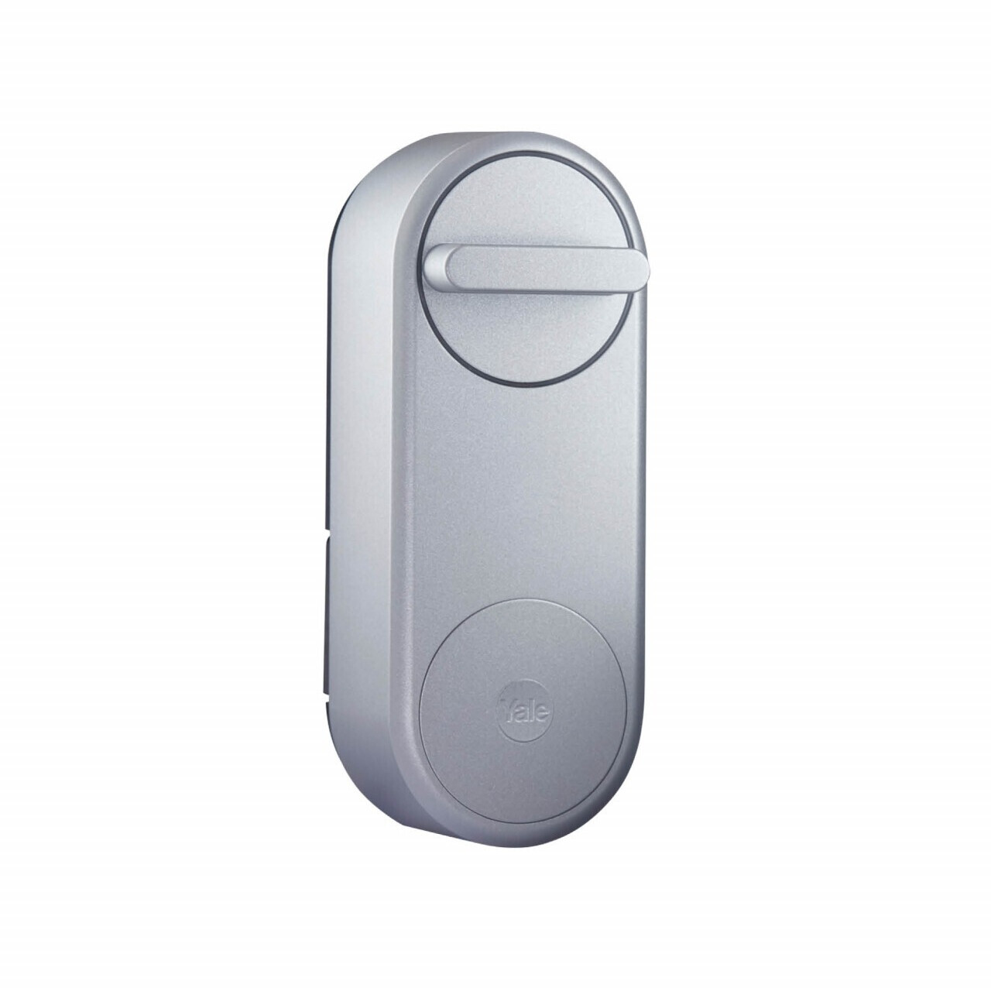
SMART LOCKS

Slide 9





SMART HOME CLOUD
THIRD PARTY CLOUD
MOBILE APP
GATEWAY
GATEWAY
SMART DEVICES
SMART LOCK

Slide 10
CLOUD-TO-CLOUD INTEGRATION
ADAPTER SERVICE
HTTPS
EXPOSED CONTROL API
EXISTING SMART HOME CLOUD
THIRD PARTY CLOUD

Slide 11
COMAND FLOW – LOCK/UNLOCK
3RD PARTY CLOUD
SMART LOCK
APP
GW
ADAPTER
PARSE COMMAND
LOCKING

Slide 12
COMAND FLOW – LOCK/UNLOCK
3RD PARTY CLOUD
SMART LOCK
APP
GW
ADAPTER
LOCKING
WEBHOOK
PARSE COMMAND
NOTIFIED

Slide 13
SECURITY
Partnership between companies
Oauth2 – access/refresh tokens
Brute force protection – webhook API
Refresh tokens – 24h
HTTPS – encrypted exchange
Token for events - recognition

Slide 14
Advantages
Easier to integrate an existing solution then start from scratch
Time and cost savings

Slide 15
MESUREMENTS
TEST CASE | TIME [ms]
End to end door lock/unlock | 9853
3rd party platform processing | 7521
Smart home side processing | 2332
OVERHEAD OF ~2s for the existing smart home side processing

Slide 16


